Slide 1
Module 6: Introduction to automation

Slide 2
Automation
Dataverse automation choices
Getting started with Power Automate

Slide 3
Logic and validation
Tables within Dataverse can leverage rich server-side logic and validation to ensure data quality.
Business rules: Business rules validate data across multiple columns in a table, and provide warning and error messages, regardless of the app that's used to create the data.
Business process flows: Business process flows guide users to ensure they enter data consistently and follow the same steps every time. Business process flows are currently supported only for model-driven apps. **these are discussed in more detail later in the course**
Workflows: Workflows automate business processes without requiring user interaction. These are sometimes referred to as “Classic workflow”.
Business logic with code: Business logic supports advanced developer scenarios that extend the application directly through code. **detailed discussion is out of scope for this course**
Power Automate: Full suite of no-code/low-code/full-code automation options to include cloud flows and desktop flows. **these are discussed in more detail later in the course**

Slide 4

What behavior is expected when the logic happens on the server?

Slide 5
Define business rules - Introduction
You can create business rules and recommendations to apply logic and validations without writing code
Tip: Business rules are usually defined for a table and apply to all forms, but you can define a business rule for a specific model-driven form. Canvas apps cannot have a business rule applied to a specific form.

Slide 6
Business rules
Automate and enforce common requirements
Rules created in the context of a table
Can execute on both client and server, depending on configuration
Provide an alternative to developer code-based rule implementation
https://youtu.be/lqEIX5MeLAk

Slide 7
Business Rules
Business rules provide a simple interface to implement and maintain fast-changing and commonly used rules.
Set column values
Clear column values
Set column requirement levels
Show or hide columns
Enable or disable columns
Validate data and show error messages
Create business recommendations based on business intelligence.

Slide 8
Differences between canvas and model-driven apps for business rules
Model-driven apps can use all actions available on business rules, however not all business rule actions are available for canvas apps at this time.
Show or hide columns
Enable or disable columns
Create business recommendations based on business intelligence.

Slide 9
Define the components of a business rule
Business rules encapsulate logic in a predefined set of steps that will run each time that data is entered or modified and the data meets certain criteria to trigger the business rule.
A business rule only applies in a canvas app when the scope set to Table.
Scope of a business rule | Applies to
Table | Model-driven forms and server
All forms | Model-driven forms
Specific form (Account form, for example) | Just that model-driven form

Slide 10
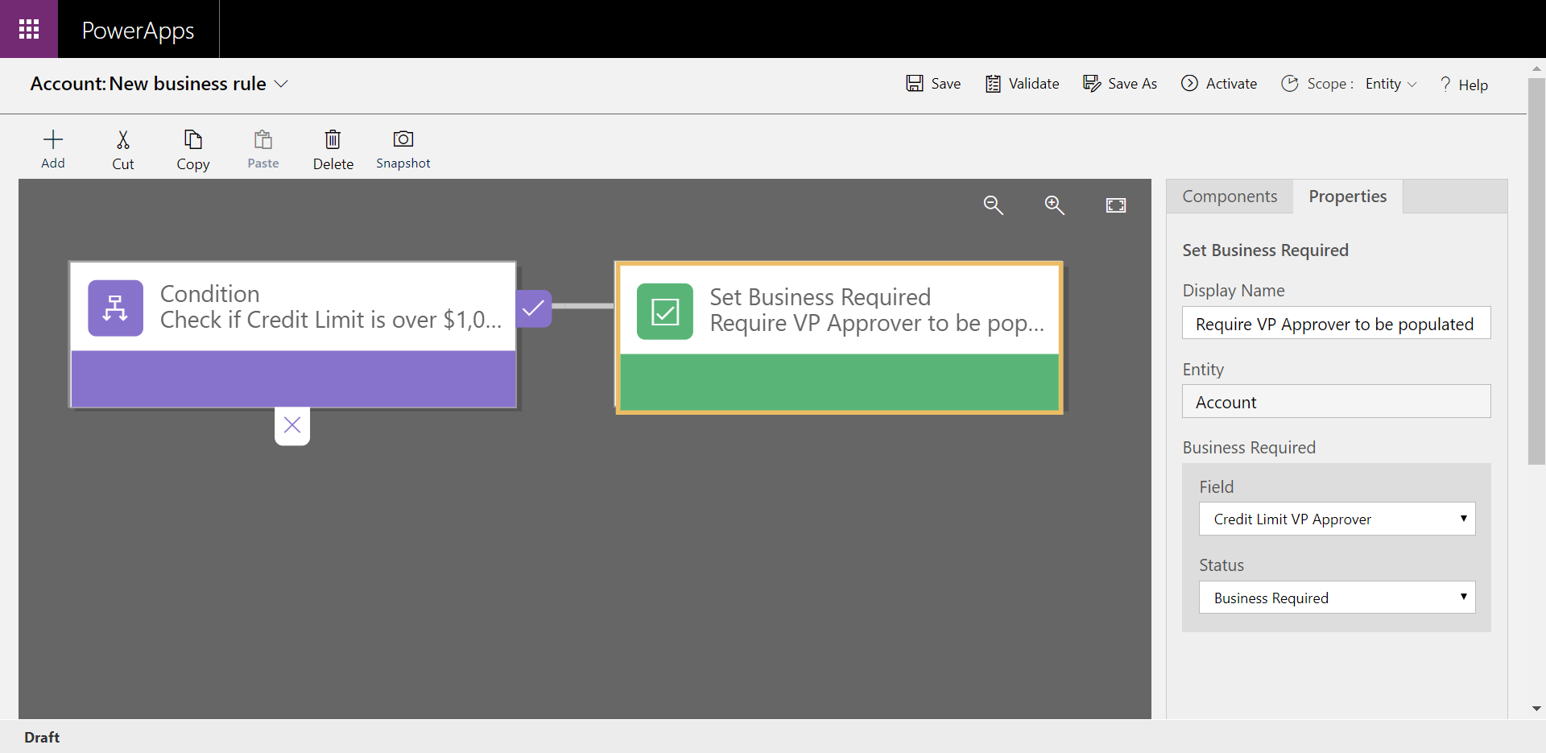
Configuring business rules

Slide 11

Demo

Slide 12
Should I use a business rule or JavaScript?
JavaScript has full access for manipulating form controls and business rules are limited on their actions
JavaScript only runs on model-driven forms where business rules can run server-side an apply to any modification of data without code
Use business rules, when possible, JavaScript when needed, avoid mixing both on same form

Slide 13
Workflows
Workflow:
Initiates automation without requiring user interaction
Flexible:
Implement multiple patterns
Durable:
Long-running and restartable
Scalable:
Low performance impact
Overview: https://youtu.be/Vf5--m_Jx4E
Demonstration: https://youtu.be/faTPgQteB38

Slide 14
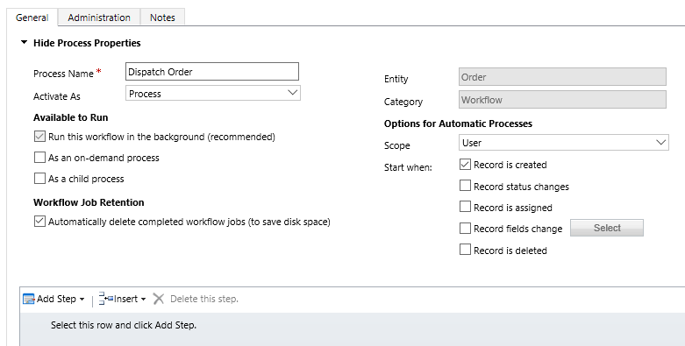
Configuring workflows
When should they start?
Automatically (in response to event like create, update, delete, change status, change ownership)
Manually by user
As a child workflow started by another workflow
Real time vs. background?
What conditions?

Slide 15
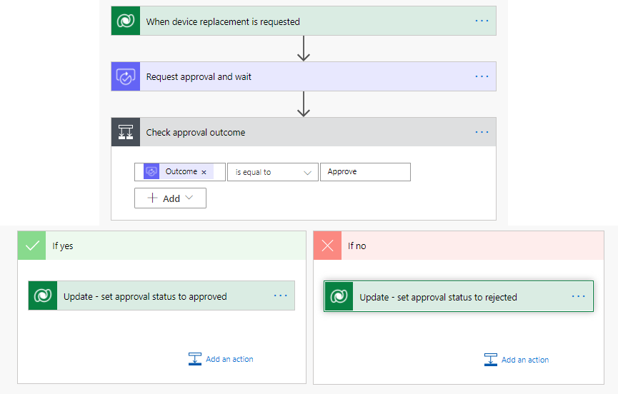
Introduction to Power Automate
Formerly Microsoft Flow
Cloud service that automates actions across one or more systems
Built on top of Azure Logic Apps
Flows can be packaged along with other Dataverse solution components

Slide 16
What can you do with Power Automate?
Use Power Automate to automate workflows between your favorite applications and services, sync files, get notifications, collect data, and much more
For example, you can automate these tasks:
Instantly respond to high-priority notifications or emails
Capture, track, and follow up with new sales leads
Copy all email attachments to your OneDrive for Business account
Collect data about your business, and share that information with your team
Automate approval workflows

Slide 17
What can you do with Power Automate?
Use Power Automate to automate workflows between your favorite applications and services, sync files, get notifications, collect data, and much more
For example, you can automate these tasks:
Automate an old desktop job estimating app that is still used
Expire all estimates over 30 days old at the end of each day
When a new estimate is created create follow up tasks for the account manager
When an estimate is accepted advance the stage of a business process
Automate approval of a discount on an estimate

Slide 18





Types of Power Automate flows
Automated flows
Instant flows
Scheduled flows
Business Process flows
Desktop flows
Cloud flows

Slide 19
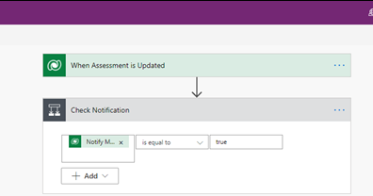
Key concepts
Every flow has two main parts:
A Trigger
The starting action of the flow such as new email arriving in your inbox or a new item being added to a SharePoint list
One or more Actions
What you want to happen when a trigger is invoked such as start the action of creating a new file on OneDrive for Business
Trigger
Action

Slide 20
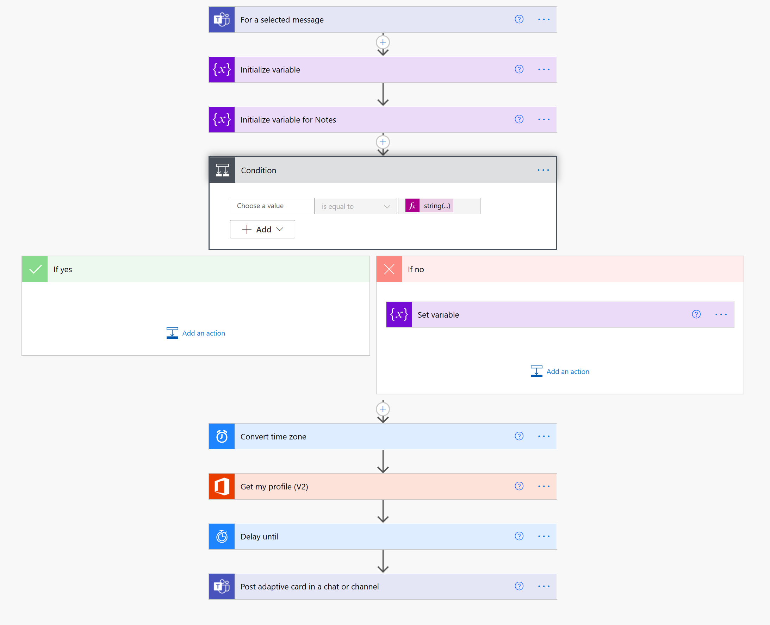
Example – Follow up on a message

Slide 21
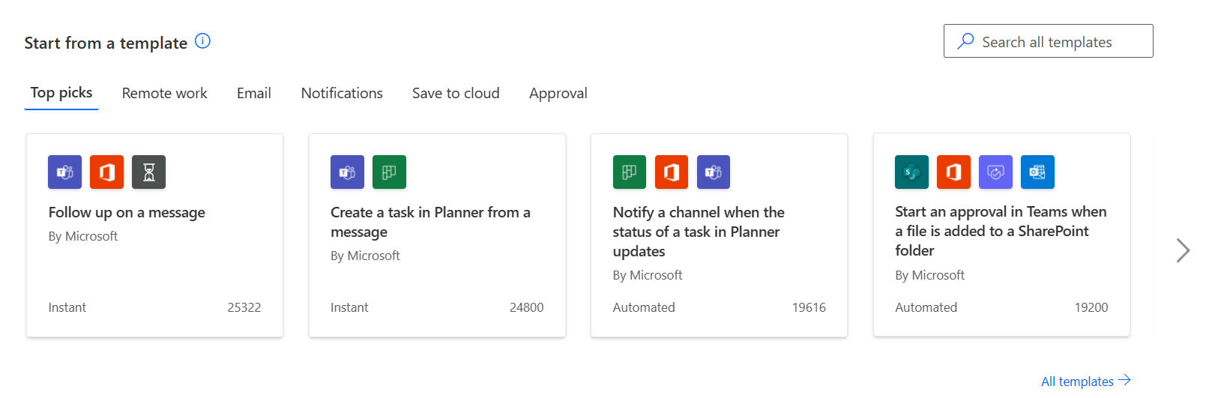
Templates
Provide a quick start for common scenarios

Slide 22
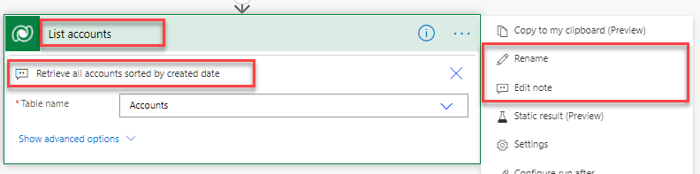
Naming
Naming flows
Most important for instant flows, since they will be selected by end users from a list of flows
All other flows will need clear names for administrators to tell what has run/failed
Naming flow actions
Every action gets default name
Trigger
Action

Slide 23
Testing and run history
Power Automate has built-in testing features
Initiate test
Trigger flow
Use data from prior run
Review Result
Modify Flow
Test Flow

Slide 24
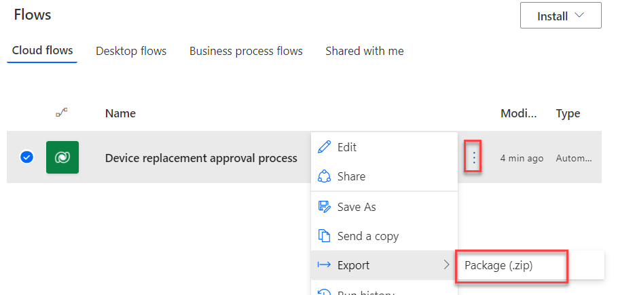

Export a flow
After a flow has been exported, anyone that you send the zip file to can import it

Slide 25
Module 6 practice labs
Lab 6.1: Configure a new business rule
Lab 6.2: Advanced business rules

Slide 26
Closing slide

